Slide 1
LEC 1
Time Value of money

Slide 2
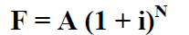
Time Value of money تأثر الوقت على المال
Interest is a payment made for using money during a given period. The interest rate is the amount of interest paid per unit of time.
الفائدة هي مبلغ يتم دفعه مقابل استخدام المال خلال فترة زمنية معينة. معدل الفائدة هو مقدار الفائدة المدفوعة لكل وحدة زمنية.
Interest rate :
Monthly, yearly, daily ……………
Suppose that one deposited an amount “A” now in the bank and the annual interest rate is i. Then, the amount to be paid by the bank after one year (called the future value F) is given by ()
F = A (1 + i)
Similarly, if this amount is deposited in the bank for N years, then its future value F after N years will be
وحدات الزمن

Slide 3
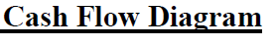
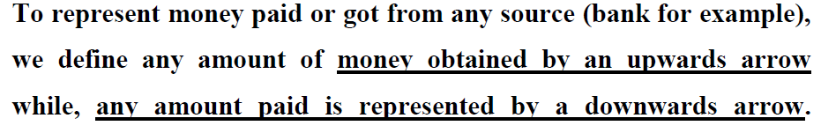
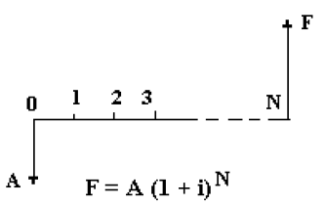

Slide 4
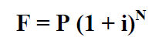
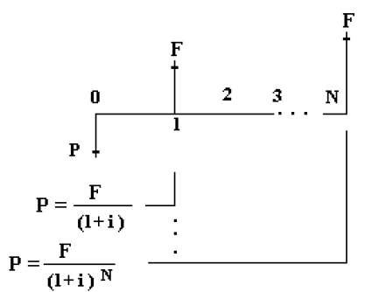
سحب
got
Years
إيداع
deposit

Slide 5
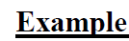
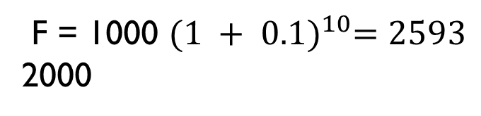
Determine the F of the cash flow
if I =10% and P = 1000 .After 10 years?
F = 1000 ${(1 + 0.1)}^{10}=2593$
2000

Slide 6
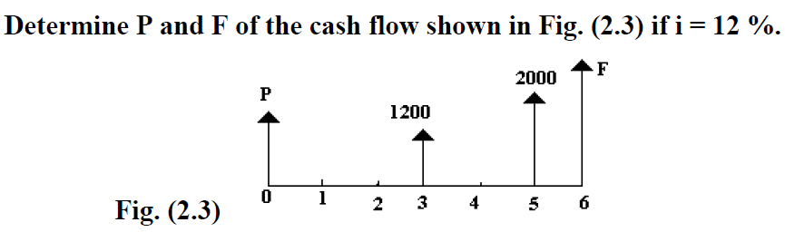
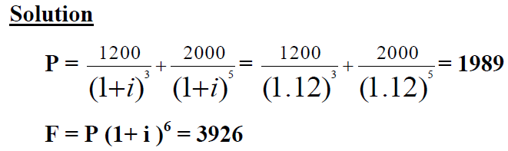

Slide 7
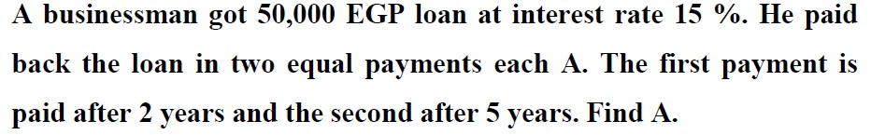
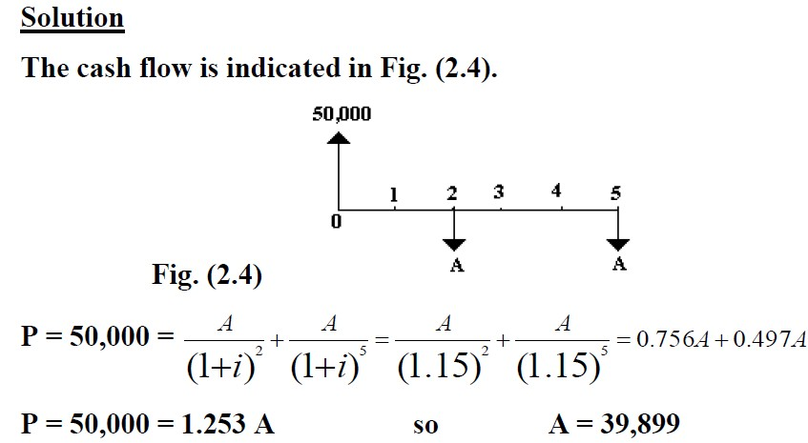

Slide 8
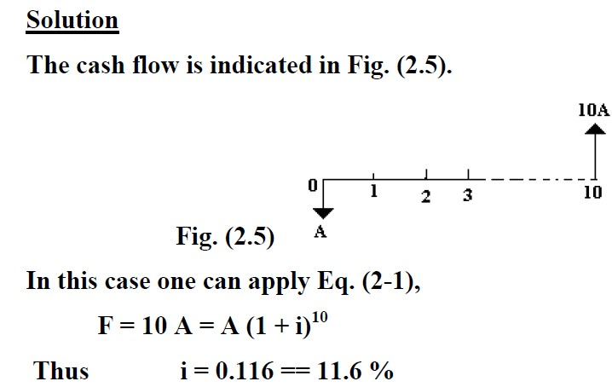
25.8

Slide 9
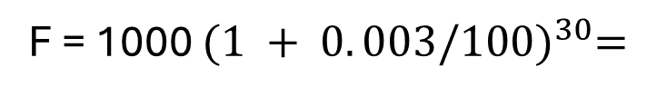
You deposited (1000 L.E) in a bank that gives you a daily interest of
(0.003%), where interest is paid monthly. Find your balanced
after 30 month
F = 1000 ${(1 + 0. 003/100)}^{30}=$

Slide 10



You deposited (1000 L.E) in a bank that gives you a daily interest of (0.003%) if you deposit another 2000 on the 11th day and withdraw 500 on the 26th day. Find balance at the end of 30 day
1- For 1000
F = 1000 * ${(1 + 0. 003/100)}^{30} =$
2 - For 2000
F = 2000 ${(1 + 0. 003/100)}^{19}$ $=$
3 - For 500
F = 500 ${(1 + 0. 003/100)}^{4} =$
4 - For feature value
F(1000)+f(2000)- f(500) =

Slide 11
LEC: 2
The sum of uniform series

Slide 12
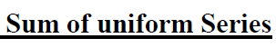
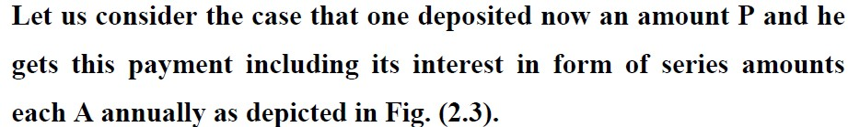
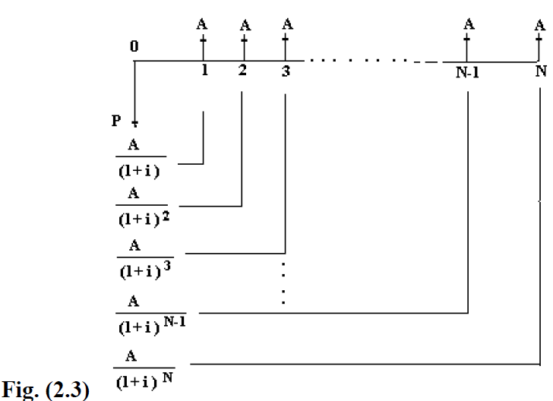

Slide 13
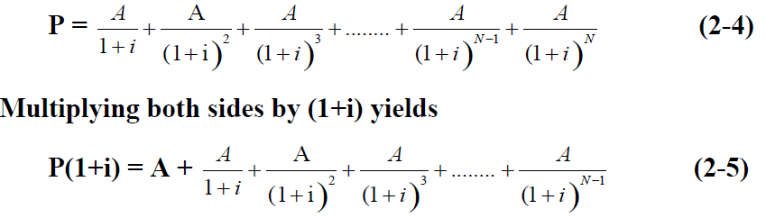
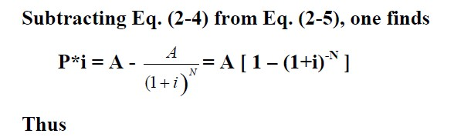
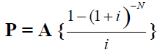

Slide 14
Note that the above Equation is valid if and only if:
P = Present rate.
A = Repeated deposit value
N = The periodic.
I = interest rate.
The first payment, A, is paid after one period from the moment when it is calculated
The periods between successive payments are equal.
The payments are equal to each A.

Slide 15
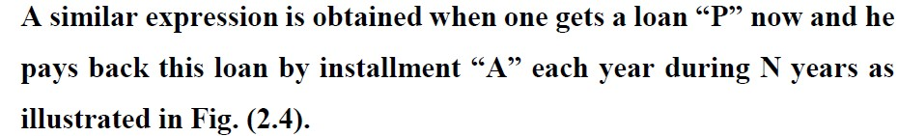
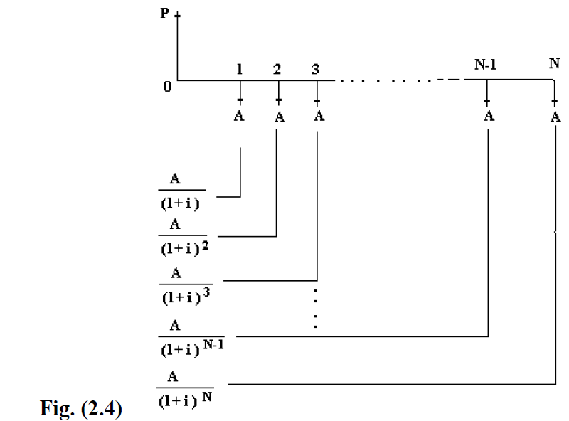

Slide 16
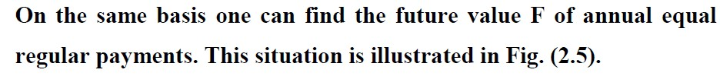
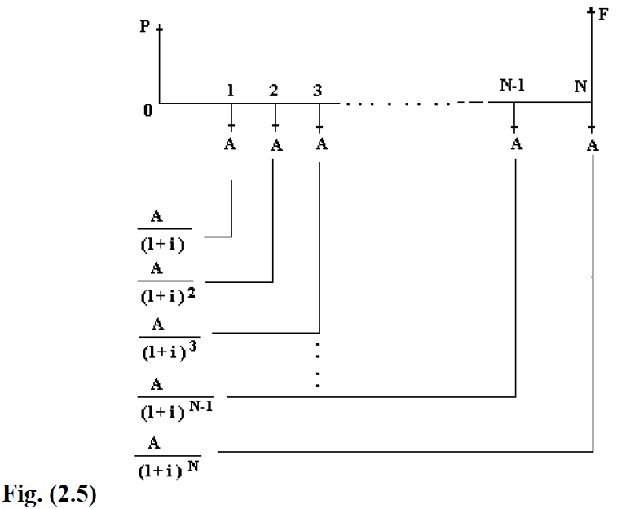

Slide 17
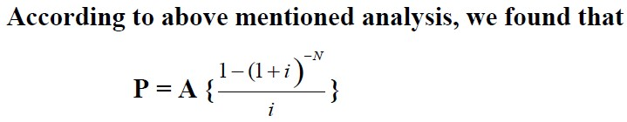
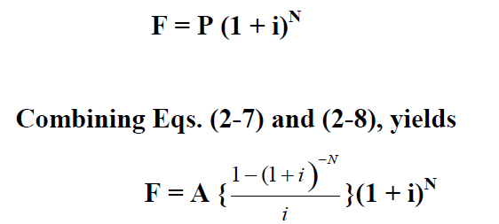
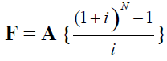

Slide 18
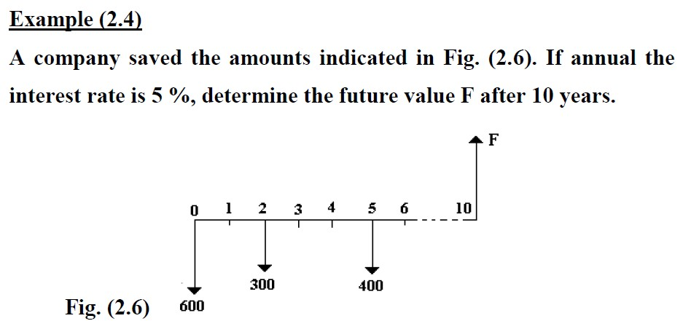
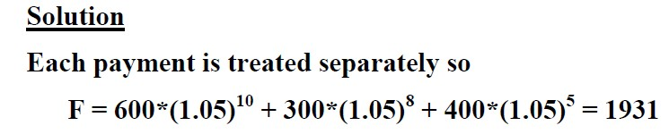

Slide 19
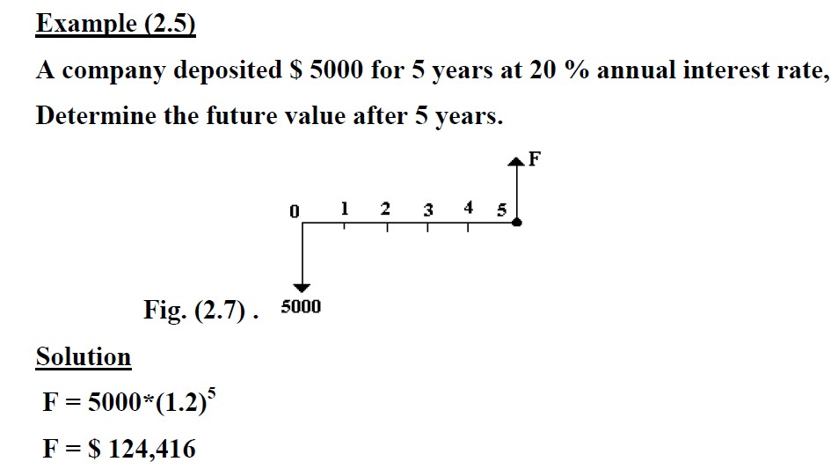

Slide 20
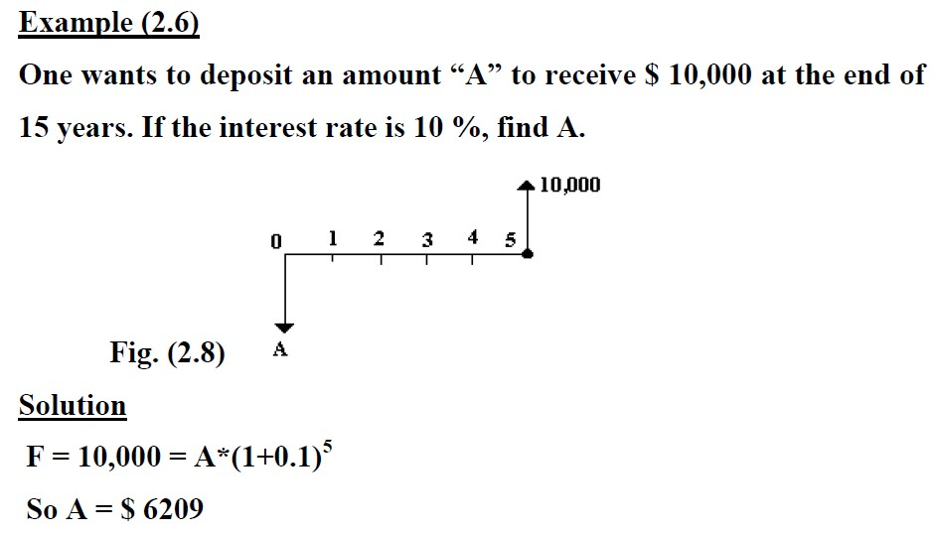

Slide 21
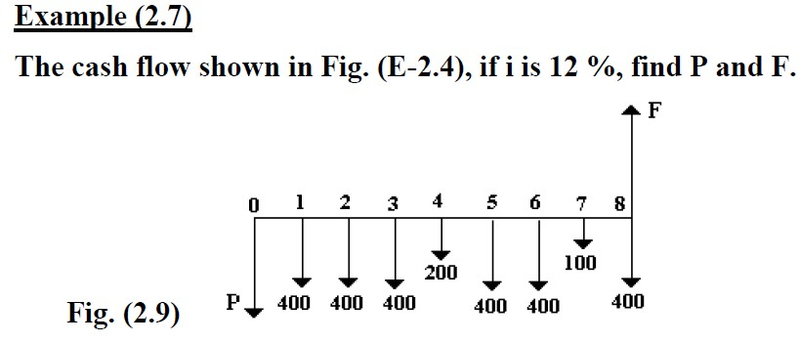
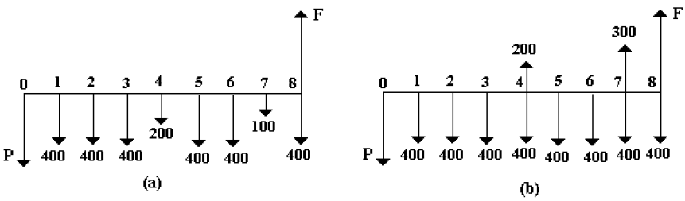
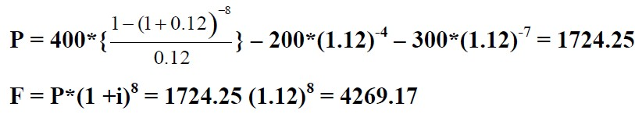

Slide 22
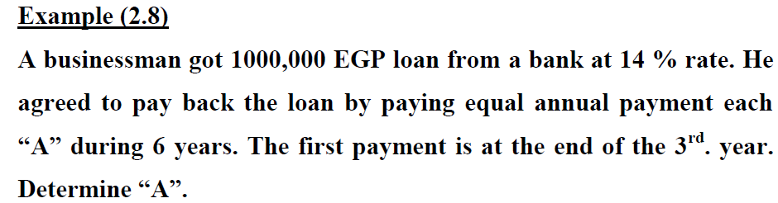
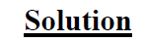
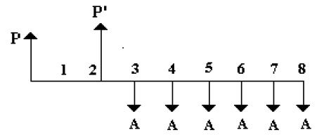
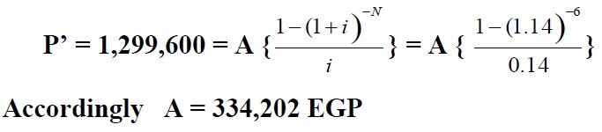

Slide 23
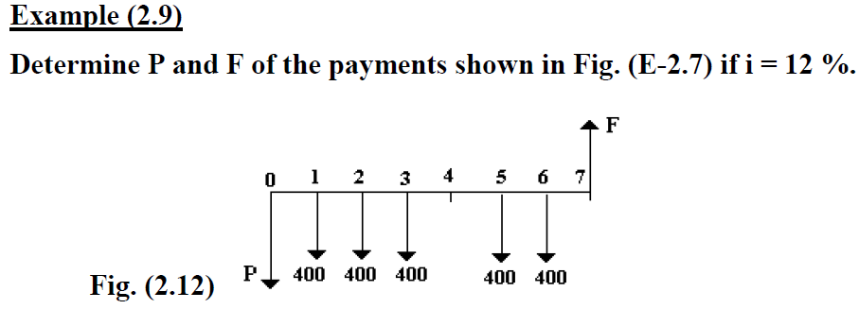
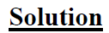
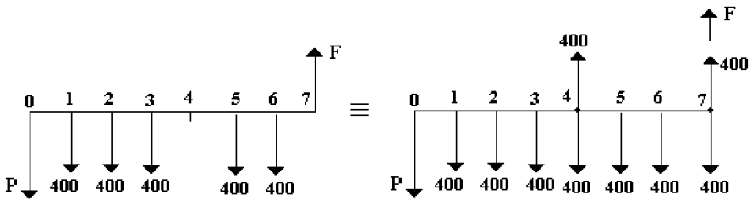
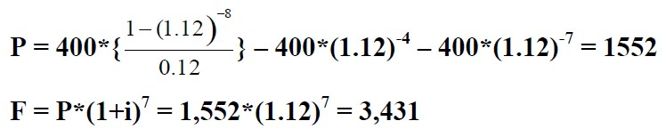

-7

Slide 24
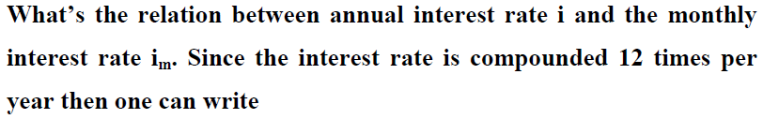
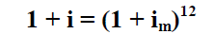
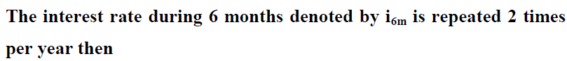
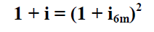
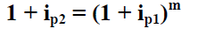
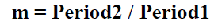

Slide 25
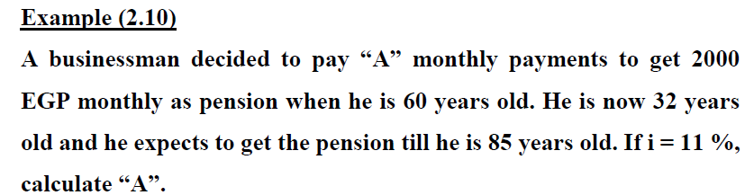
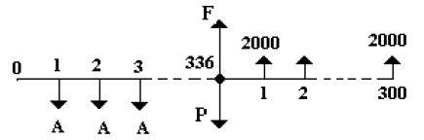



Slide 26



Slide 27
LEC 3: Interest Rate during different periods

Slide 28


In many economics problems we encounter the problem of finding the sum of arithmetic gradient series of payments, i.e. payments increases (or decreases) uniformly each period.

Slide 29







Slide 30


The above Equations are applied if and only if

Slide 31





(A = -5000, G = - 1000 $, N = 4, and i =0.15)

Slide 32





(A = -8000, G = + 1000 $, N = 4, and i =0.15)

Slide 33



Slide 34



(A= 0, G = 1000, N = 5, and
i = 0.12)

Slide 35
LEC 4:

Slide 36








Slide 37




Slide 38


A = 1000, g = 0.2, i = 0.1, and N = 4.

Slide 39



1+ g = 0.8, i.e. g = - 0.2, A = 1000 and i = 0.25.

Slide 40


In some transactions, the interest rate is not given, and one has to determine its value. An example of this is buying a car by installment, where one pays a down payment then he pays a monthly predetermined value for a given period.

Slide 41





Slide 42






Slide 43




Slide 44
LEC 4:

Slide 45
Economic Comparison of Alternatives
This section addresses the challenge of selecting one alternative among many options. The decision is informed by economic analysis.
Present Value Analysis
We divide our analysis into two parts: one for equal lifetimes and another for different lifetimes.
Equal Lifetimes
This analysis calculates the present value of each alternative's cost or profit, assuming equal lifetimes for all options.

Slide 46







Slide 47
Non-Equal Lifetimes
For example if the lifetimes are 4 and 6 years, then LCM is 12 years. This 12 years period includes two periods of 6 years and 3 periods of 4 years.
الرقم الأولى الذى يقبل القسمه عليه الرقمين
2 | 4 | 6
 | 2 | 3
2*2*3

Slide 48


Slide 49




Slide 50




2-Annual Cost Analysis

Slide 51




Slide 52



-4

Slide 53
LEC 4:

Slide 54

Capitalized Cost Analysis

Slide 55




Slide 56



Slide 57



Slide 58


Slide 59



Slide 61





3-Payback Period

Slide 62





Slide 63

4-Internal Rate of Return Method

Slide 64





Slide 65





Slide 66




Slide 67


Incremental Investment Analysis

Slide 68




Slide 69


Slide 70



Slide 71




Slide 72



Slide 73




Slide 74


Slide 75




Slide 76


Slide 77





Slide 78


Slide 79







Slide 80







Slide 81





Slide 82


Slide 83





Slide 84




Slide 85






Slide 86



Slide 87



Slide 88






Slide 89



Slide 90








Slide 91







Slide 92









Slide 93






Slide 94







Slide 95





Slide 96





Slide 97




Slide 98



Slide 99



Slide 100







Slide 101



Slide 102



Slide 103



Slide 104



Slide 105







Slide 106
THANK YOU

